Slide 1
The Parents’ Guide to
Google Classroom

Slide 2
What is
Google Classroom?
Think of Google Classroom (GC)
as your child’s digital link to learning.
Teachers use GC to share assignments, homework, newsletters, and much more with students!

Slide 3
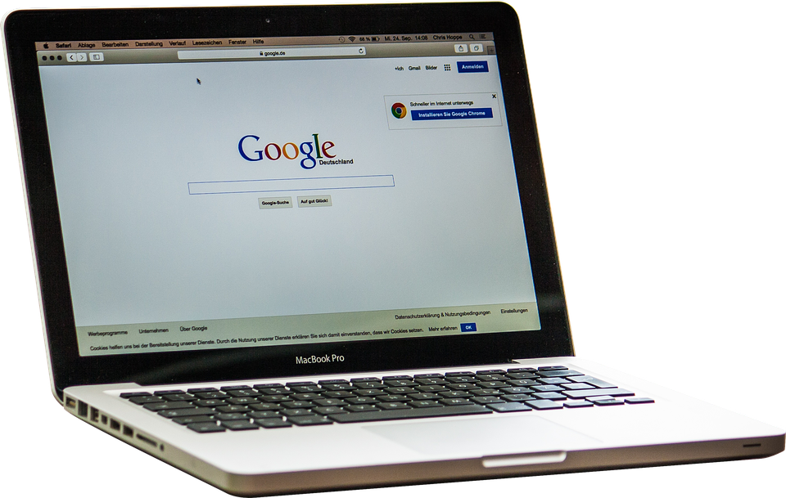
Getting Started
Your child was provided with a secure login and password that is unique to them.
Your child's ‘Google’ email address is their Glow username followed by @sl.glow.scot
E.g
Glow: gw12smithjohn@glow.sch.uk
Google email: gw12smithjohn@sl.glow.scot

Slide 4
Getting Started
Click on the Google Chrome browser icon.

Slide 5
Getting Started
Type www.google.com into your web
address bar.

Slide 6
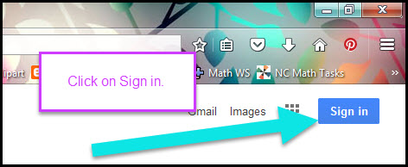
Getting Started
Click on SIGN IN in the upper right hand corner of the browser window.

Slide 7
This is where you need to be careful.
Type in your child’s Google Email address & click “next.”

Slide 8
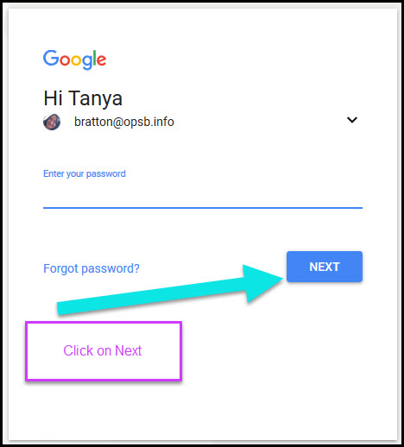
Getting Started
Type in your PASSWORD
& click “next.”

Slide 9
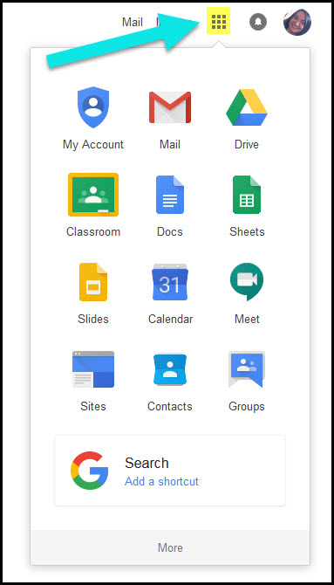
Google
suite
Click on the 9 squares
(Waffle/Rubik’s Cube) icon in the
top right hand corner to see
the Google Suite of Products!

Slide 10
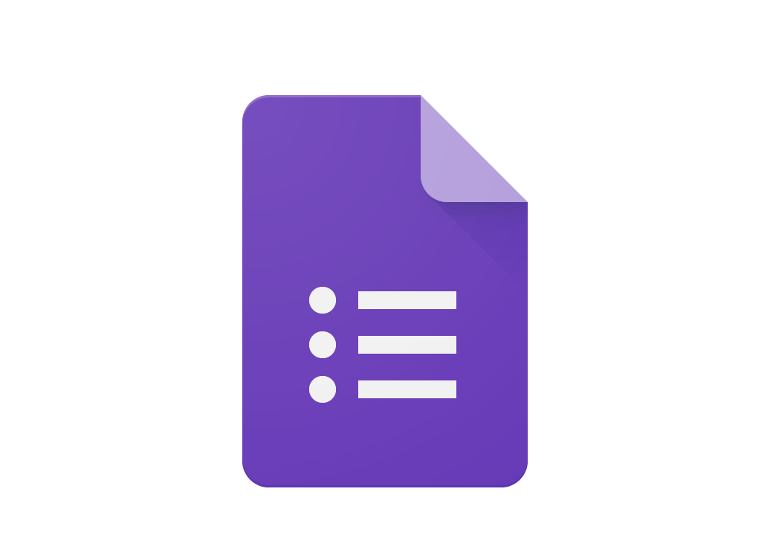
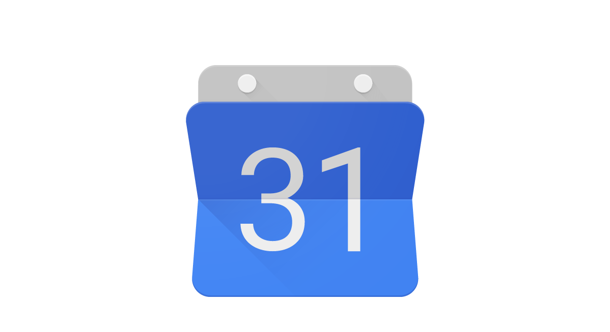
GOOGLE ICONS to recognize:
CHROME DOCS DRIVE SLIDES SHEETS FORMS CALENDAR
GMAIL PHOTOS MAPS KEEP CLASSROOM MEET HANGOUTS
SITES CONTACTS CLOUD CLOUD SEARCH YOUTUBE NEWS VAULT
MY ACCOUNT GROUPS

Slide 11
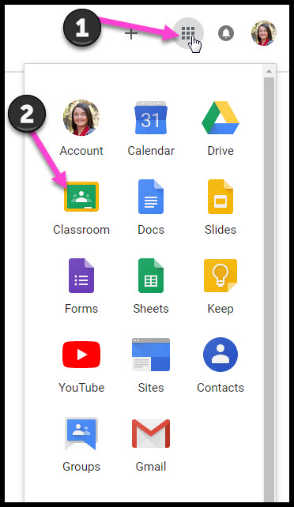
Navigating Classroom
Click on the waffle button and then the
Google Classroom icon.

Slide 12
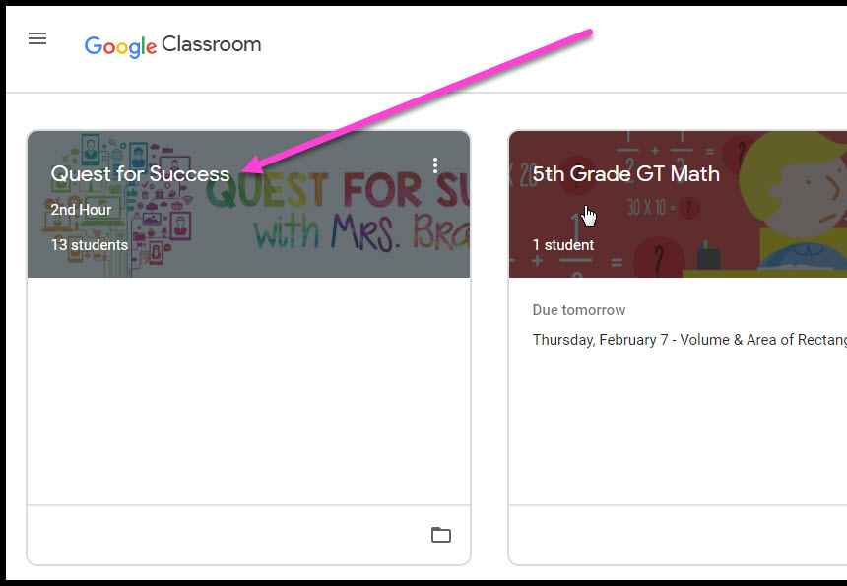
Navigating Classroom
Click on the class you wish to view.

Slide 13
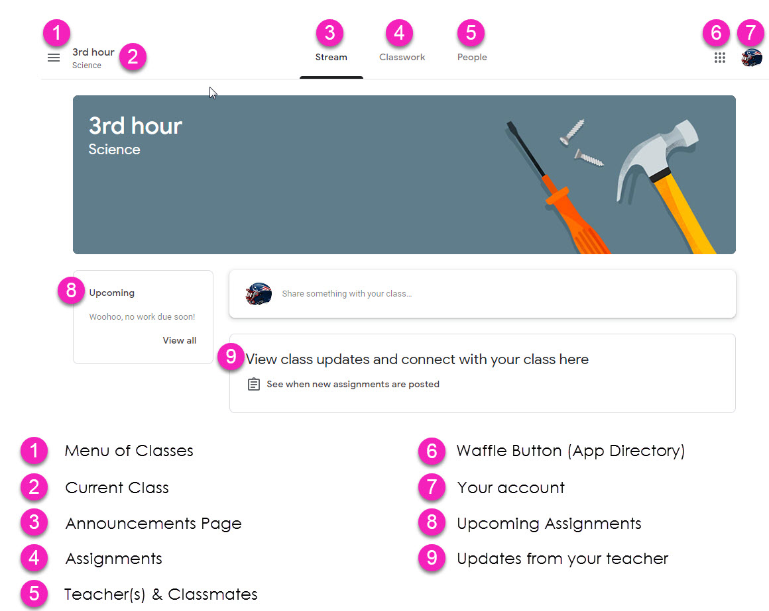
Navigating Classroom
= High Interest for Parents
Page tools
(Left side)

Slide 14
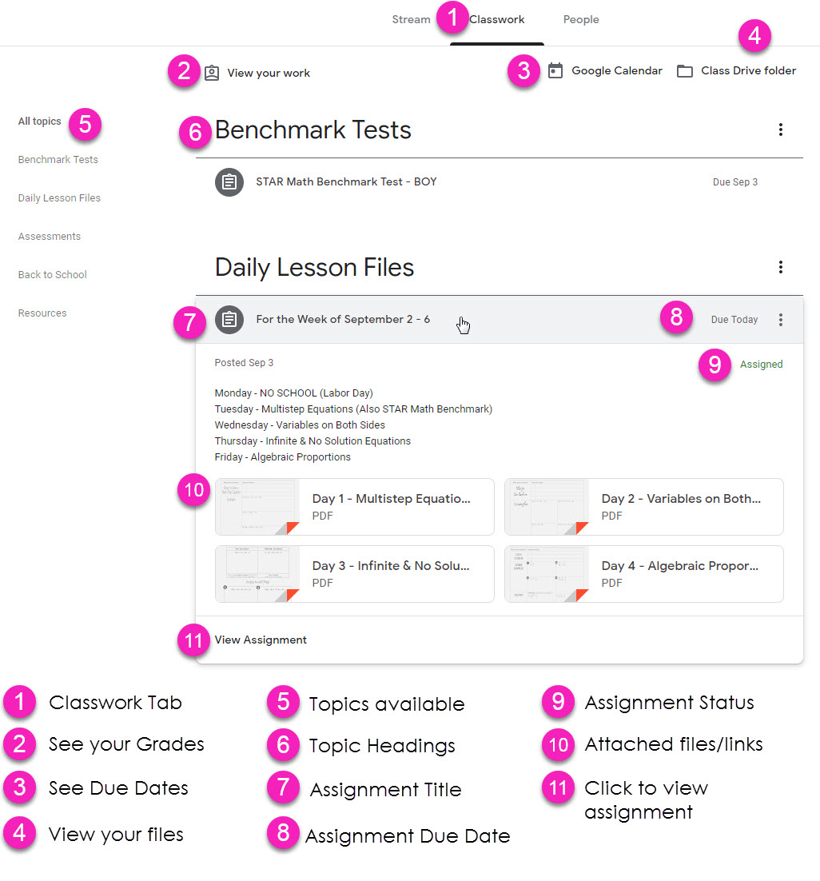
Navigating Classroom
Assignment details

Slide 15
Access
Google Classroom can be accessed in many ways and on many devices.

Slide 16
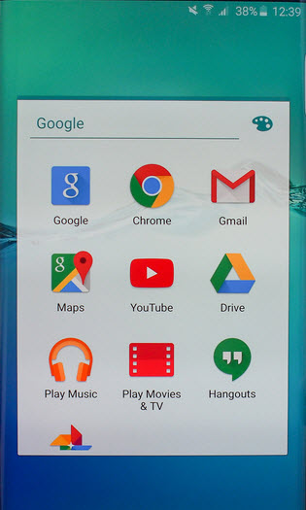
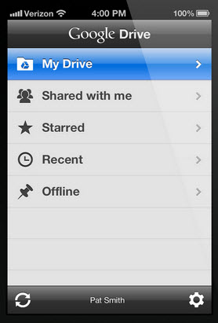
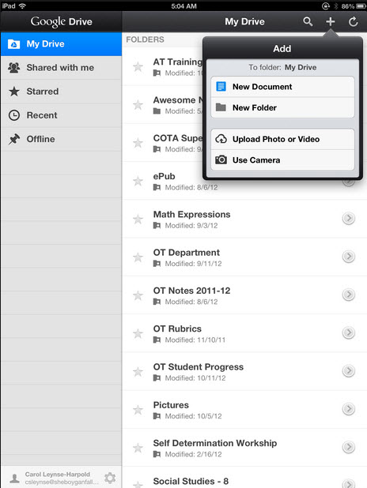
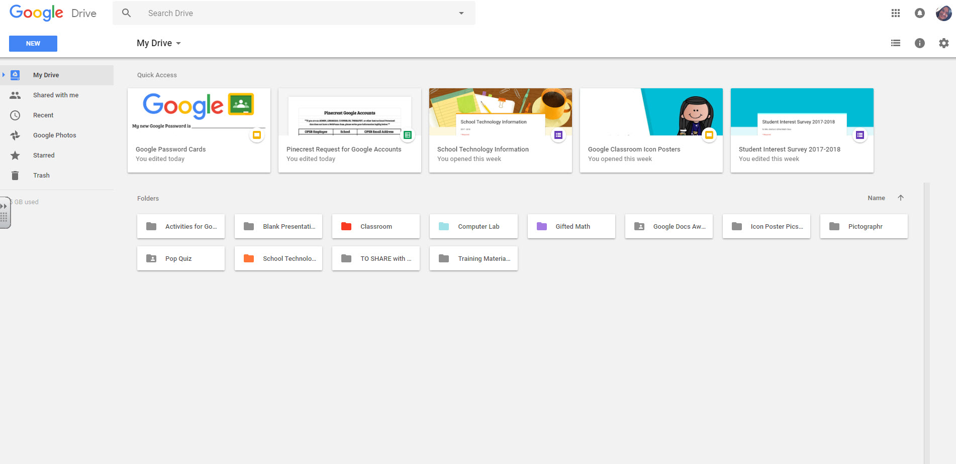
access
anywhere
Android
Iphone
Tablet
desktop

Slide 17
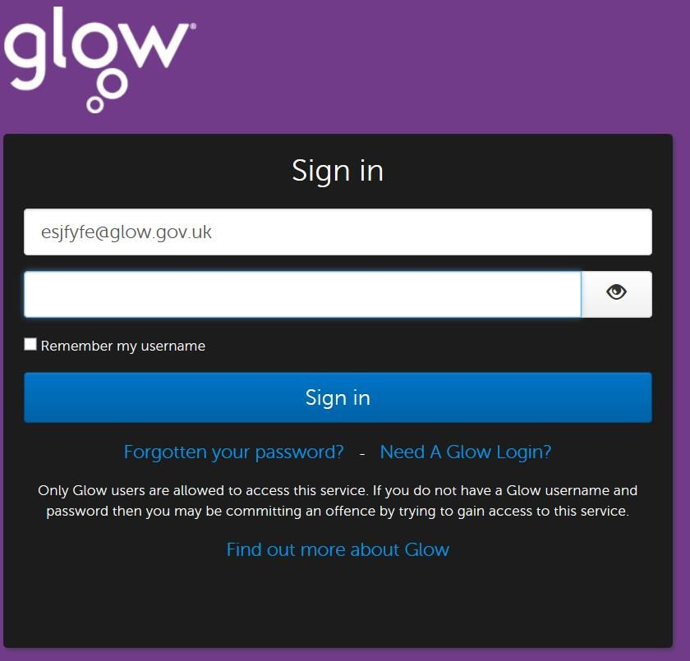
1. Joining Google Classroom via Glow Email .
Log into your glow account.
2. Open the Google Classroom Invite from your teacher. Click to join class.
( You might need to enter your classroom code)

Slide 18
2. Accessing Google Classroom via Glow.
Log into your Glow account and click on the Google Classroom tile (on your launch pad or search for it)
2. Access Google Classroom using your class code. (sent via email)

Slide 19
3. Accessing GLOW via PS4.
Click on the link below:
https://youtu.be/mHTHaXhccDE

Slide 20
4. Accessing Google Classroom via Xbox.
Click on the link below:
https://youtu.be/gxTIdrjIT_Q

